Slide 1
From On-Premises to Cloud:
Lessons Learned from an Enterprise AWS Migration at Fannie Mae
Wujian Xue
Oct 2026
Cincinnati, OH
2026 Women in Statistics and Data Science Conference, Cincinnati, OH

Slide 2
Agenda
Background - Fannie Mae
Cloud Migration
My work in the migration
Additional value: Efficiency and Accuracy
Gen AI and future of code conversion
2026 Women in Statistics and Data Science Conference, Cincinnati, OH

Slide 3
1. Background - Fannie Mae
Business:
  Buy mortgage from lenders across the U.S., give lenders cash to make more home loans.
  Pool most of the loans into mortgage-backed securities(MBS) and guarantees investors timely payment of principal and interest.
  Earns guarantee fees on the security and interest income on the loan
Numbers:
  Chartered by the Congress in 1938, under federal conservatorship in 2008.
  Hold $4.3 trillion assets, financed 25% homes in the U.S.
Cloud migration
Time to customer value
Organize for effectiveness
Digital stability
Business Innovation at speed
Enable transformation
Intelligent automation
2026 Women in Statistics and Data Science Conference, Cincinnati, OH

Slide 4

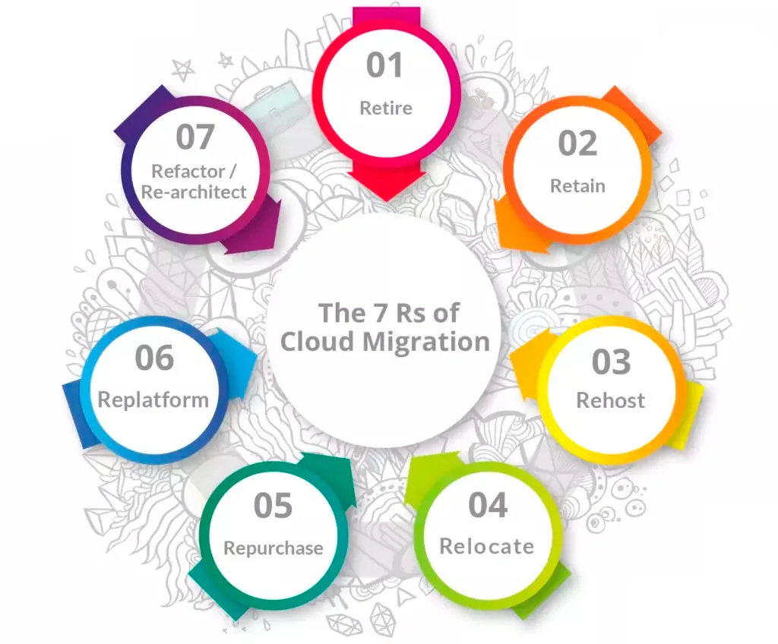
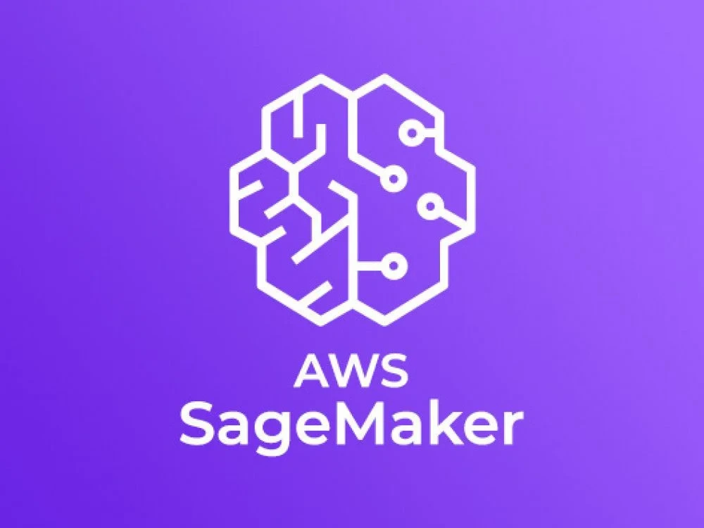



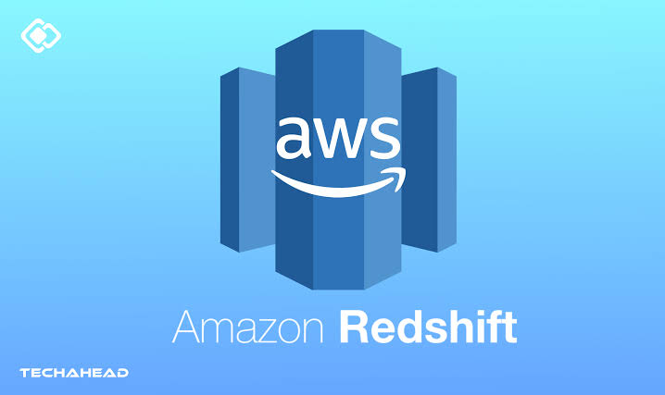
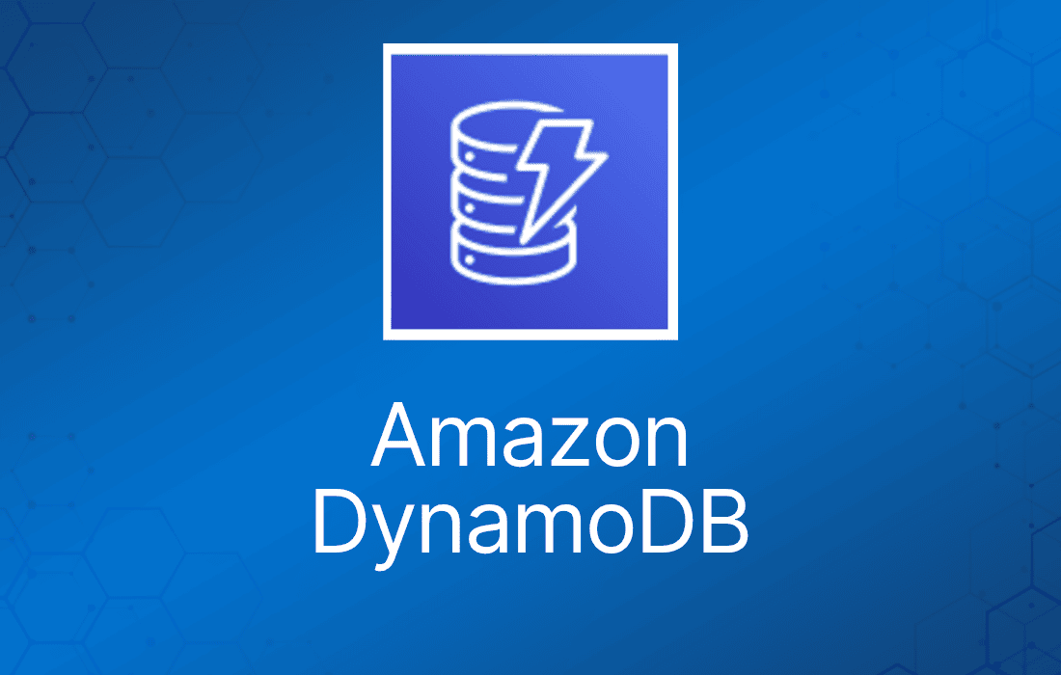
2.Cloud Migration in Fannie Mae
7 Rs in AWS Cloud Migration
2026 Women in Statistics and Data Science Conference, Cincinnati, OH

Slide 5









2. Cloud in other organizations
Financial regulators, banks, Asset management companies, payment companies and exchanges also have cloud migration.
2026 Women in Statistics and Data Science Conference, Cincinnati, OH

Slide 6
3. My work in the cloud migration
I worked in EMA to migrate CCAF models from SAS to R/Python
EMA
CCFA
Loss severity
Enterprise Modeling and Analytics
Common Cash Flow Applications
Dollar loss / unpaid principal balance
Technologies:
R/RStudio
SAS
Unix
WinSCP
Putty
Git
Python
2026 Women in Statistics and Data Science Conference, Cincinnati, OH

Slide 7
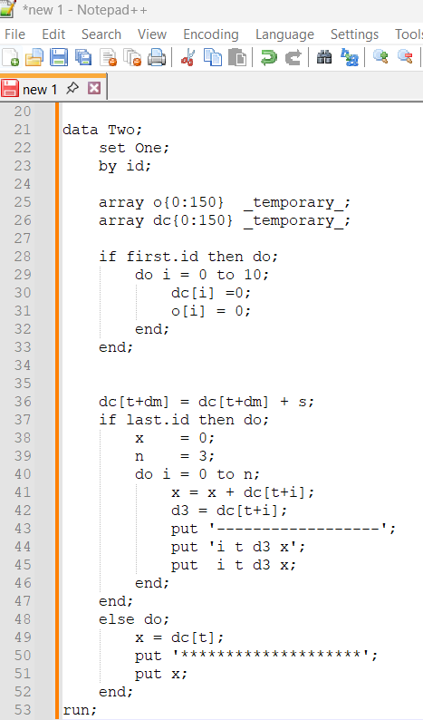
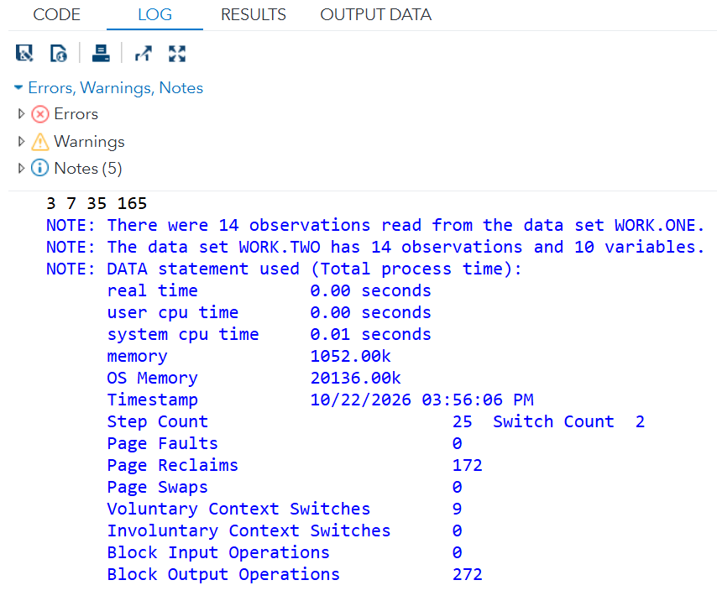
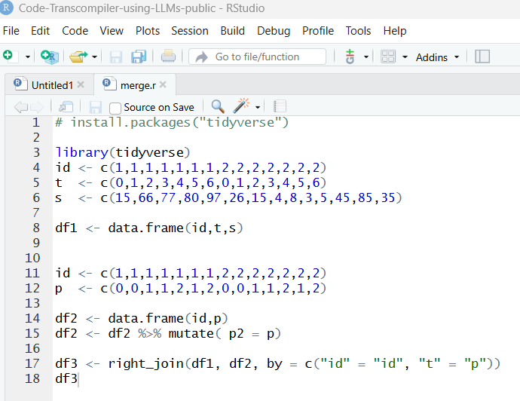
3. My work in the cloud migration
I don’t have access to SAS. I only have the SAS code and log files. I asked my teammates to create some intermediate datasets.
Sample
2026 Women in Statistics and Data Science Conference, Cincinnati, OH

Slide 8
3. My work in the cloud migration

